Slide 1
Best Practices Tutorial
The primary objective of Best Practices is to provide guidance, based on assembled industry expertise and experience, for network reliability and resiliency.
September 9, 2026

Slide 2
Best Practices Guidelines
Proven through actual implementation – more than “just a good idea”
Address classes of problems (rather than one-time issues)
A single concept should be captured in each practice (one thought, one practice)
Should not endorse specific commercial documents, products, or services
Developed through rigorous deliberation and expert consensus
Confirmed by a broad set of stakeholders
Should not be assumed to be applicable in all situations or to all industry types
Does not imply mandatory implementation

Slide 3
Best Practice Format
All Best Practices should follow the format of:
“__________________ should ___________________”
1st blank “Who”: consists of the implementer (i.e., Network Operators, Service Providers, Equipment Suppliers, Property Managers, Public Safety, Government)
2nd blank “What”: consists of the Best Practice. The Best Practice may include the use of a modifier after the word “should” (e.g., Network Operators should consider, etc.)

Slide 4
Best Practice Example
First Blank- WHO
Modifier
Second Blank- WHAT
  Network Operators, Service Providers and Equipment Suppliers should ensure that all network infrastructure equipment meets the minimum requirements of ANSI T1.319 (fire resistance).
  In order to prevent fire. GR63 NEBS Requirements: Physical Protection, Telcordia at http://telecom-info.telcordia.com/site-cgi/ido/docs2.pl?ID=170086171&page=home; ATIS-0600319.2008 Equipment Assemblies—Fire Propagation Risk Assessment Criteria at http://www.atis.org/docstore
Supporting information, found in Reference section.
Should be located in the reference section. Does not belong in actual BP.

Slide 5
Best Practice Numbering Format
For existing NRIC/CSRIC Best Practices:
Each Best Practice has a unique numbering format:
XX - YY - Z###
XX = the current, or most recent, NRIC/CSRIC Council
(e.g., 8 in 2009-2010)
YY = the Council in which the Best Practice was last edited
Z =
  0 and 4 for Network Reliability and Interoperability
  1 for Disaster Recovery and Mutual Aid
  3 for Public Safety
  5 for Physical Security
  8 and 9 for Cyber Security
### = any digits, where every Best Practice has a unique Z###
CS | XX-YY-ZZZZ | XX-YY-ZZZZ
NRIC III | 1 | 1
NRIC IV | 2 | 2
NRIC V | 3 | 3
NRIC VI | 4 | 4
NRIC VII | 5 | 5
NRIC VIII | 6 | 6
CSRIC I | 7 | 7
CSRIC II | 8 | 8
CSRIC III | 9 | 9
CSRIC IV | 10 | 10
CSRIC V | 11 | 11
CSRIC VI | 12 | 12
CSRIC VII | 13 | 13
CSRIC VIII | 14 | 14
CSRIC IX | 15 | 15
CSRIC X | 16 | 16
CSRIC XI | 17 | 17

Slide 6
Other Considerations
For each new Best Practice (BP) identify:
Recommended Category
  Public Safety & Disaster
  Standard
Industry Role(s)
Network Type(s)
Applicable Keyword(s)
Reference/Comments
Recommended Category (for number assignment purposes)
  Network Reliability and Interoperability
  Disaster Recovery and Mutual Aid
  Public Safety
  Physical Security
  Cyber Security

Slide 7
Best Practice Network Types
Cable
  An entity that provides communications through direct connectivity, predominantly by coaxial cable or optical fiber, between the serving central office and end user location(s).
Internet/Data
  An entity that provides internet and/or data communications through direct connectivity, predominantly by wire, coaxial cable, or optical fiber, between facilities-based and non-facilities-based serving networks and end user location(s).
Satellite
  An entity that provides communications through satellite connectivity.
Wireless
  An entity that provides communications through radio spectrum allocation, predominantly by cellular architecture and/or CMRS networks between the mobile switching center(s) and end users.
Wireline
  An entity that provides communications through direct connectivity, predominantly by wire or optical fiber, between the serving central office and end user location(s).

Slide 8
Best Practices Industry Roles
Network Operators
  An entity responsible for the operation, administration, maintenance, and provisioning (OAM&P) of communications networks.
Service Providers
  An entity responsible for providing communications services for consumer and business customers.
Equipment Suppliers
  An entity that supplies organization whose business is to supply network operators and service providers with equipment and/or associated software required to render reliable network service.
Property Managers
  An entity responsible for the operation of a physical location that houses communications equipment.
Public Safety
  An entity that administers and/or operates a Public Safety Answering Point (PSAP) or the public safety network.
Government
  A federal, state, tribal, or local government agency.

Slide 9
Categories
Public Safety & Disaster
  Best Practices that are deemed vital for 911 mechanisms (e.g., keeps 911 up) and those that promote widespread recovery following a disaster.
Standard
  All other Best Practices.

Slide 10
Best Practices Recommended Keywords
Access Control
  Limiting and/or documenting physical access to buildings, equipment and/or systems.
Buildings
  Physical structures that house communications equipment or employees.
Business Continuity
  Corporate wide program that has been established for the purpose of internal planning for and responding to emergency situations impacting services, employees or assets.
Contractors & Vendors
  Non-employees working on behalf of the company or providing goods/services (not visitors).
Corporate Ethics
  Corporate values and integrity for organizations supporting public communications infrastructure.
Cyber Security
  The protection of information and systems against unauthorized disclosure, transfer, modification, or destruction, whether accidental or intentional.
Disaster Recovery
  Steps taken after an emergency event has occurred to recover from the event.
Documentation
  Information concerning the operation/location of communications equipment and networks. This DOES NOT necessarily include everything written but may include information in a draft format.
Emergency Preparedness
  Steps taken prior to an emergency event occurring that will facilitate the restoration from the event.
Encryption
  Steps taken to make data unusable to any other person(s) or system(s) other than for whom it is intended.

Slide 11
Best Practices Recommended Keywords (continued)
Essential Services
  Ensuring the continued operation of vital services (911, priority circuits).
Facilities-Transport
  Inter-office facilities used to carry communications (e.g., copper, fiber, free space).
Fire
  Preventing, controlling, or extinguishing combustion of materials at or near telecommunications equipment.
Guard Services
  People tasked for safeguarding facilities, physical assets, and personnel.
Hardware
  Equipment used to support communications networks.
Human Resources
  Processes and procedures relating to personnel within a company.
Industry Cooperation
  Collaboration between separate business entities.
Information Protection
  Safeguarding the confidentiality and integrity of a company’s proprietary information.
Intrusion Detection
  Actions taken to alert users or administrators when an unauthorized entity has attempted or has succeeded in accessing a system or database. This denotes cyber intrusion and does not cover physical intrusion.
Liaison
  Maintaining communications through a working relationship with other entities.
  Material Movement
  Physical movement of materials (i.e., logistics).
  Network Design
  Planning and configuration of communication networks.
  Network Element
  Unique equipment that is a component of a network.

Slide 12
Best Practices Recommended Keywords (continued)
  Network Interoperability
  Interaction of networks that must work together to provide communications.
Network Operations
  Tasks required to operate a network.
Network Provisioning
  Steps taken to activate equipment/services in a network.
Pandemic
  Related to the preparation or reaction to wide-spread epidemic or epidemic in a specific area.
Physical Security Management
  Anything having to do with safeguarding the physical assets of the corporation.
Policy
  High level management statements of a desired condition (not detailed procedures).
Power
  Electrical systems (AC/DC) used to operate communications equipment.
Procedures
  Instructions for specific tasks.
Public Safety Service
  Related to emergencies and 9-1-1 services used by individuals or corporations.
Security Systems
  Hardware/Software devices specifically used to monitor and control security.
Software
  Code specific to running communications equipment.
Supervision
  Direct management of tasks workers.
Technical Support
  Providing assistance in installing, maintaining, or restoring equipment.
Training & Awareness
  Company provided instruction or other means of education on specific topics.
Visitors
  Individuals who are not employees/contractors/vendors.

Slide 13
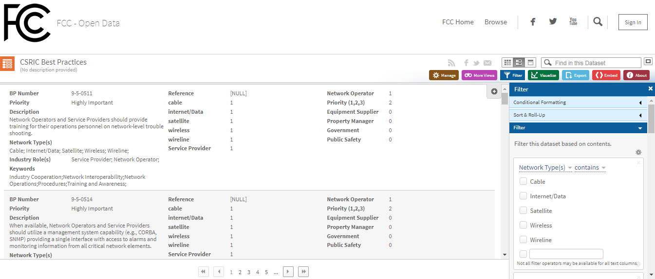
FCC Best Practices Website
Direct link: https://opendata.fcc.gov/Public-Safety/CSRIC-Best-Practices/qb45-rw2t/data (url last validated 2/10/20)
Also linked on NORS webpage: https://www.fcc.gov/network-outage-reporting-system-nors

Slide 14
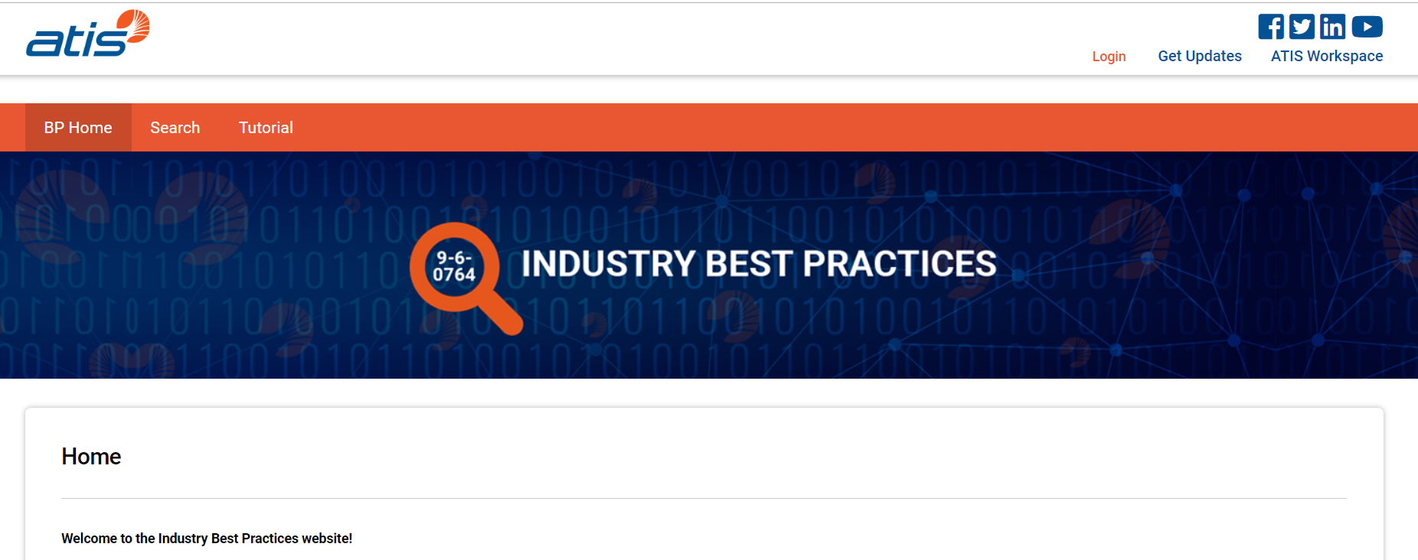
ATIS Best Practices Website
Direct link: https://bp.atis.org/

Slide 15
NRSC Membership
To learn more about NRSC initiatives and the advantages of participating through ATIS, please contact:
Jackie Wohlgemuth, ATIS Director - Global Standards Development (jwohlgemuth@atis.org)
- or -
Rich Moran, Director of Membership (rmoran@atis.org)
NRSC Website: http://www.atis.org/nrsc

